Slide 1
COLLEGE MANAGEMENT SYSTEM (CMS)
PRESENTED BY:
Team 04: CSE-A
B. RAKESH [22C31A0523]
A. NAVYA [22C31A0503]
A. SAI VARDHAN [22C31A0504]
A. ABHINAYA [22C31A0514]
G. KARTHIK [22C31A0553]
Guided By :
Dr. Raziya Begum
Associate Professor, CSE

Slide 2
ABSTRACT
The College Management System is a comprehensive software application designed to automate and streamline the administrative and academic processes of a college or educational institution.
This system integrates various functions such as student enrollment, faculty management, course allocation, fee processing, attendance tracking, and academic performance monitoring into a centralized platform.
Developed using Python - Django, the system offers user-friendly interfaces for administrators, faculty members, and students, ensuring secure access to relevant modules based on user roles.
The main goal of the project is to reduce manual workload, minimize errors, and improve overall efficiency in managing college operations.

Slide 3
LITERATURE SURVEY
Tang, Y.F., & Zhang, Y.S(2009, August). [1] Design and Implementation of College Student Information Management System Based on Web Services. Tang and Zhang designed a student information management system using web services with Role-Based Access Control(RBAC). The system ensures high security while providing functionalities such as database management, role-specific access, and efficient handling of student records .
Hashim N. M. Z., & Mohamed, S. N. K,. S.(2013).[2] Development of Student Information System. Hashim and Mohamed created a student information system tailored for the Faculty of Electronics & Computer Engineering at universiti Teknikal Malaysia Melaka (UTeM). Using Rapid Application Design (RAD) methodology, the system focuses on recording and updating student data efficiently while providing reports for faculty use.

Slide 4
Patnaik, S., Kumari Singh, K., R., & Kumari, n. (2016).[3] College Management System. Patnail et al. Developed an automated college management system to replace traditional paperwork with digital solutions. The system they made categorizes users based on roles I.e., Students or Faculty and provide functionality such as attendance tracking, fee management, and academic record maintenance.
D B Heras, D. Otero, and F. Arguello,[4] developed an eco-feedback system to enhance the sustainability in universities. The system integrates virtual environments and human-computer interfaces to monitor ecological practices. It provides real-time feedback to users. It encourages sustainable behaviour and improving environmental performance metrics with academic institutions.
Y Wang, B Y Sun, and F Cheng,[5] developed a model for managing image archives using electronic documentation. This process improves efficiency in storing,retrieving, and managing visual data in universities. The model focuses on digitization to streamline archival workflows, ensuring better organization.

Slide 5
PROBLEM STATEMENT
Colleges often rely on manual methods to handle essential tasks like student registration, attendance tracking, fee management, and academic record-keeping. These processes are time-consuming, error-prone, and inefficient, especially as the institution grows. Manual systems lack real-time data access, lead to miscommunication, and slow down decision-making. There is a need for an automated College Management System to streamline operations, reduce errors, and centralize information. By providing secure, role-based access to students, faculty, and administrators, the system can improve efficiency, data accuracy, and communication across departments, ultimately enhancing the overall management and academic experience.

Slide 6
METHODOLOGY
The methodology includes :
Requirements Gathering :
Identifying key features such as admin , faculty and student credentials (gmail , password).
System Design :
Designing the user friendly interface using HTML ,CSS, JavaScript and implementing Django as the Backend realtime data handling authentication.
Implementation :
Frontend Development : HTML, CSS ,JavaScript allows easy User Interface creation and also provides real-time data validation.
Backend Development : Using Django which is a pyhton backend web Framework provides inbuilt database (sqlllite3) and also managing of the files (templates, views , models) are very easy in Django.

Slide 7
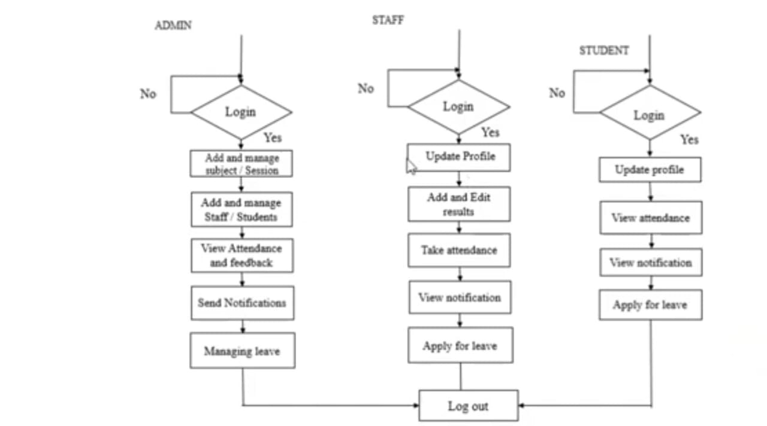
Flow Diagram:

Slide 8
Existing System
The existing system for college management is often manual, which can lead to errors, time wastage, and increased paperwork. A college management system (CMS) can help improve the efficiency of a college's operations by automating and centralizing administrative tasks.
Less accurate
The system may be less accurate and efficient, and it may be more prone to mistakes in calculations.
Time consuming
The system may be time consuming, and it may involve a lot of paperwork.
Maintenance problems
The system may have maintenance problems due to the manual work and paperwork.
No Online communication
Their is no online communication for leave applying, feedback and other to their higher authorities.

Slide 9
Proposed System
User-Friendly Interfaces: The system provides distinct interfaces for different user roles—Head of Department (HOD), staff, and students—making navigation intuitive for each group. This separation enhances user experience by catering to specific needs and functionalities for each role
Digital Connectivity: In the context of increased digital education due to events like the COVID-19 pandemic, this system facilitates seamless communication between students, staff, and administration. It helps in managing registrations, attendance, feedback, and leave applications efficiently
Comprehensive Features: The project includes a wide range of functionalities such as user registration, attendance tracking, leave management, feedback systems, and profile management. This comprehensive approach addresses various administrative needs within a college environment
Utilization of Modern Technologies: By leveraging Django as a web framework along with HTML, CSS, JavaScript, and Bootstrap for front-end development, the project ensures a modern and responsive design that can be easily maintained and scaled

Slide 10
MODULES
Admin:(HOD)
Login
Update profile
Course add/update
Subject add/update
Staff add/manage
Student add/manage
Faculty leave
Feedback of Staff/Student

Slide 11
Staff/ Faculty:
Login
Update staff details
Add student details
Update attendance details
Share file
Apply for leave
Notifications
Feedback
Student:
Login
Update staff details
Update Profile
Add student details
View notification
Update attendance details
View attendance
Share file
Apply for leave
Feedback

Slide 12
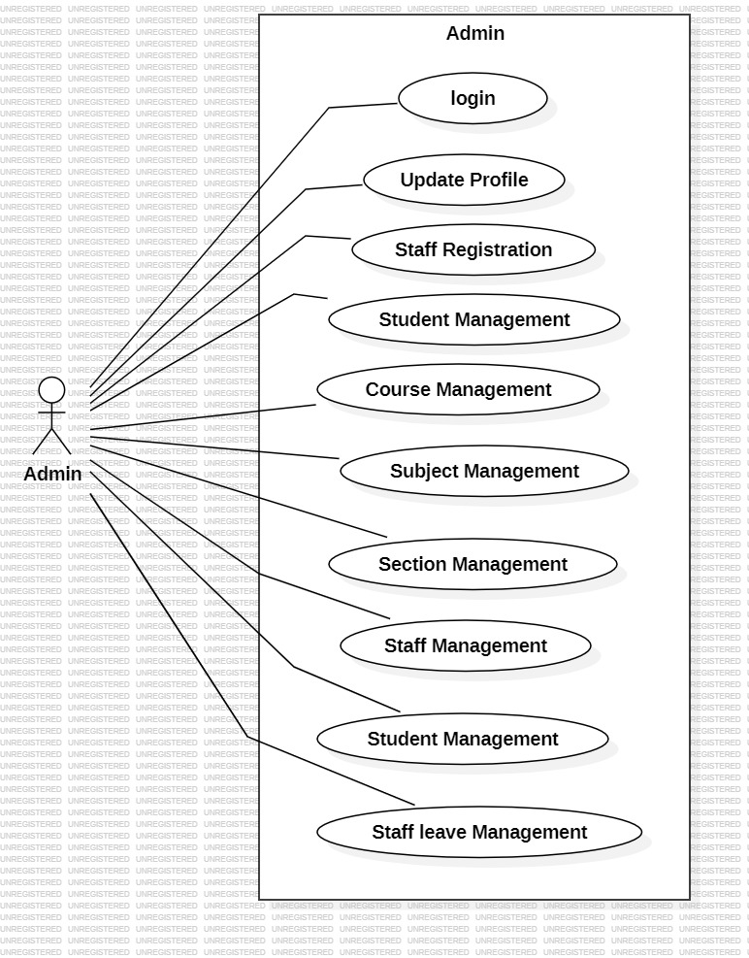
UML DIAGRAMS
Fig 1: Usecase diagram for Admin

Slide 13
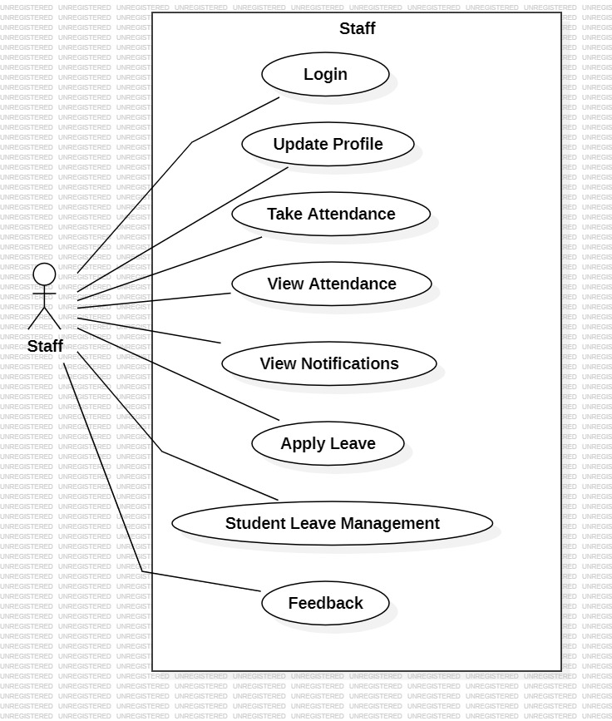
Fig2: Usecase diagram for Staff

Slide 14
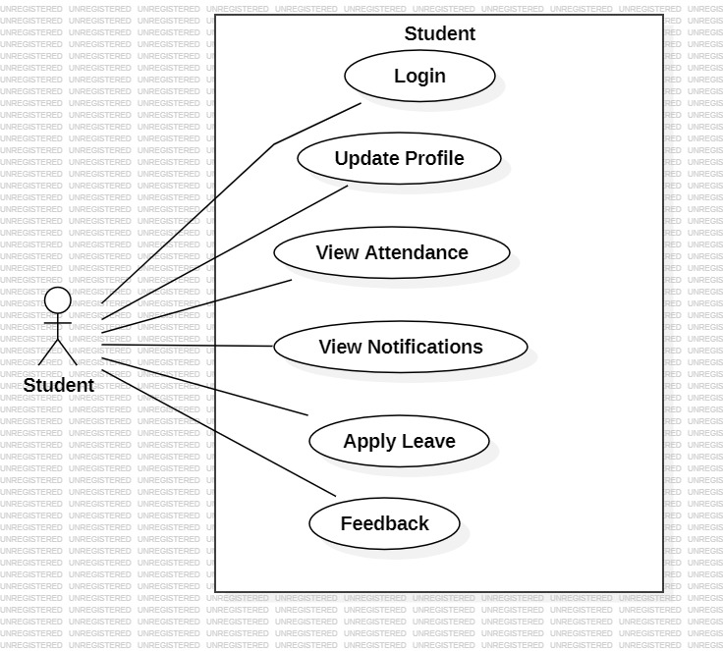
Fig 3: Usecase diagram for Student

Slide 15
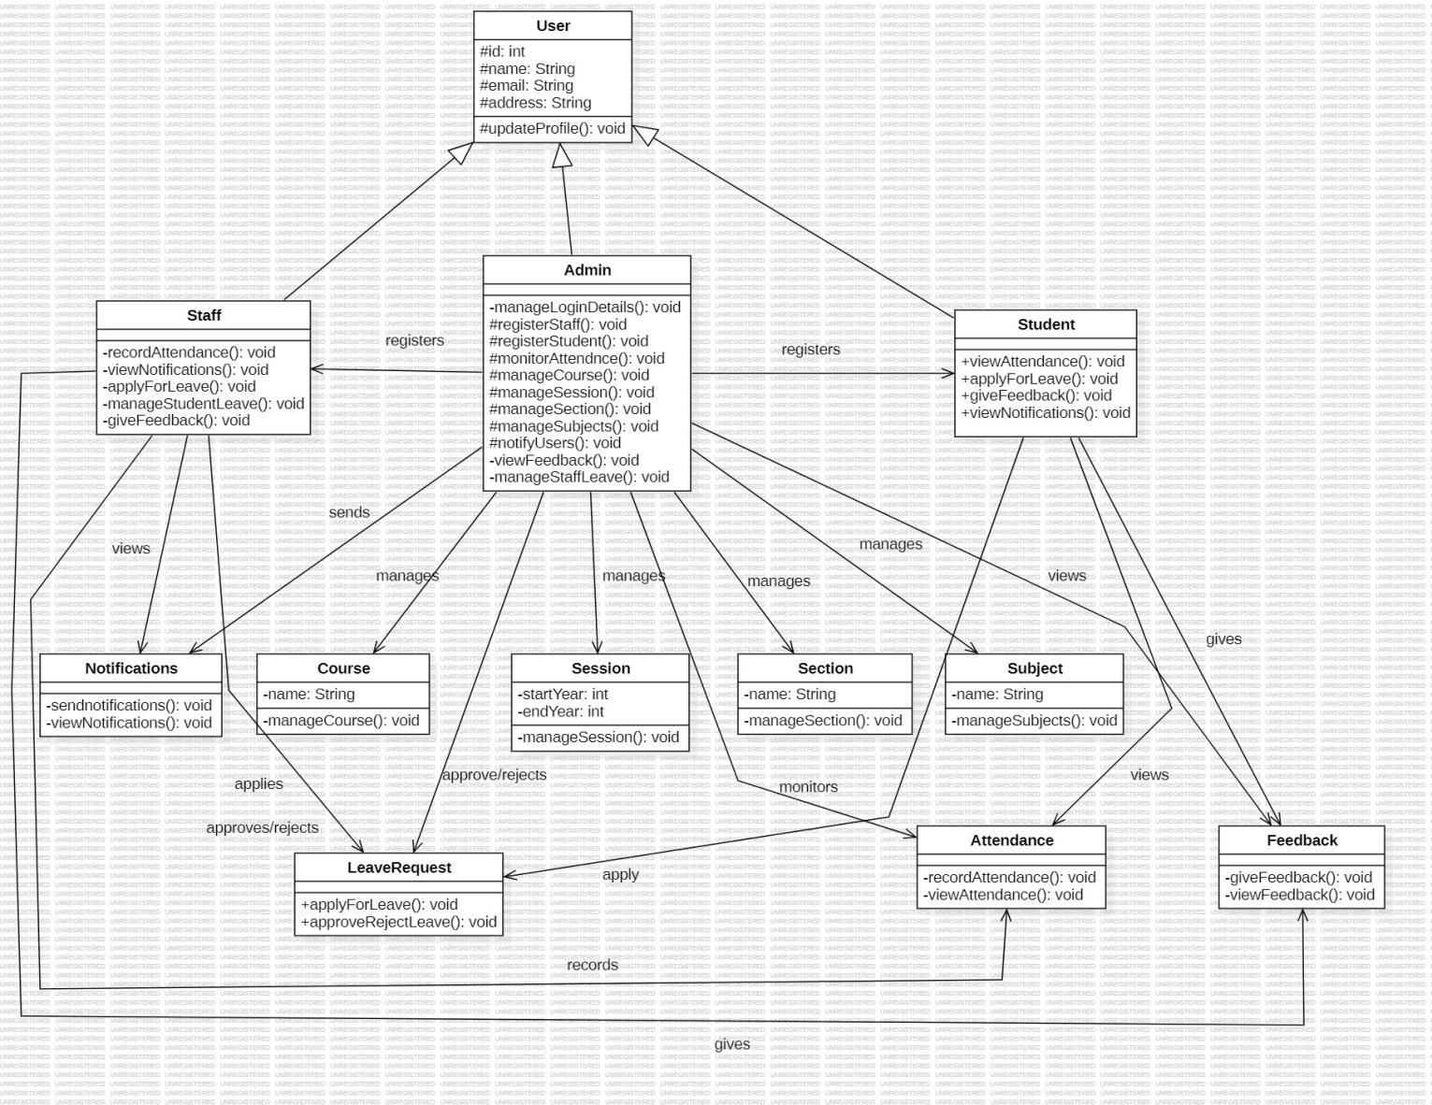
Fig 4: Class Diagram

Slide 16
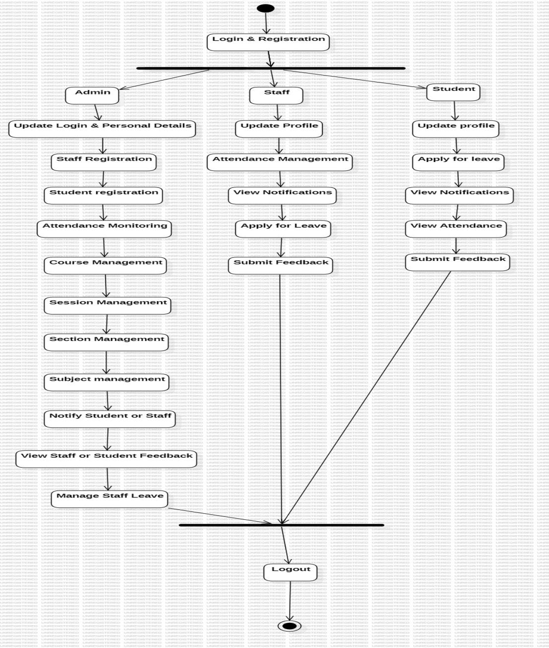
Fig 5: Activity Diagram

Slide 17
DESIGN
1. System Design
System design defines the architecture and components of the College Management System. It includes how different modules interact, how data flows, and how the user interface is structured.
a. Architecture Design
Three-tier architecture:
Presentation Layer (UI): Interface for users (students, faculty, admin)
Business Logic Layer: Processes user inputs, applies rules (attendance, fees, results)
Database Layer: Stores and manages data (MySQL, PostgreSQL, etc.)
b. Module Design
Admin Module – Manage users, courses, fees, and reports
Faculty Module – Mark attendance, input grades, manage schedules
Student Module – View profile, attendance, results, fees, and receive updates

Slide 18
IMPLEMENTATION
The implementation phase involves coding and configuring the actual system based on the design.
a. Technologies Used
Frontend: HTML, CSS, JavaScript
Backend: Python
Database: MySQL
b. Development Process
Setup of database schema
Creation of dynamic web pages for login, registration, dashboards
Backend logic to handle CRUD operations (Create, Read, Update, Delete)
User authentication and role-based access control
Integration of modules for attendance, marks, fees, and reports

Slide 19
c. Testing
Unit testing for each module
Integration testing for module interactions
User Acceptance Testing (UAT) with sample data

Slide 20
CONCLUSION
In conclusion, College Management System that was developed with Django addresses the inefficiencies of traditional college institutions and is comprised of a student panel for student to manage their academic responsibilities, attendance, grades, schedules, and leave requests, staff panel to mange the inefficient processes of administrative staff so they can put more focus on teaching and improving student experience,and the Admin panel to manage the centralized skills of attendance tracking, result management, timetabling, and leave request processing. This system reduces drawbacks of manual systems for various reasons, including data loss, delays, and workload increase, improves communication between college community members, and leads to increased efficiency throughout the college. Finally it lays the foundation for future potential improvements in technology - including mobile application ability, insights from artificial intelligence on student experience. Overall, this College Management System represents a real step forward in creating organizational efficiencies of academic instituitions.

